Slide 1
Full proof of Nash Theorem in high dimensions
By using Brouwer’s fixed point theorem
Reference:
A Tutorial on the Proof of the Existence of Nash Equilibria
Albert Xin Jiang, Kevin Leyton-Brown , November 09, 2007
Department of Computer Science, University of British Columbia
(NashReport.pdf (ubc.ca))

Slide 2
Contents
Prove Sperner’s lemma by Mathematical induction.
Introduce Simplex
Proving of Sperner’s lemma
Prove Brouwer’s fixed point theorem by Sperner’s lemma.
Prove the existence of NE by Brouwer’s fixed point theorem.
Introduce the Nash equilibrium (NE)
Proving existence of NE

Slide 3
Proof of Sperner’s lemma
By using mathematical induction

Slide 4
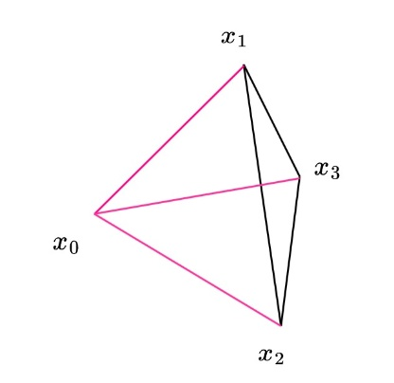

Some Definition
Sperner’s lemma
Convex combination:
For a vector: $x= (x_{0}, x_{1},…, x_{n})$ and a nonnegative scalars $λ_{0}, …, λ_{n}, \sum_{i=0}^{n}{λ_{i}}$ = 1
The vector: $\sum_{i=0}^{n}{λ_{i}x_{i}}$ is the convex combination of $x$.
Affine independence:
The set $X:\{x_{0},x_{1},…, x_{n}\}$ is Affine independent if the set
$\left\{x_{1}−x_{0}, x_{2}−x_{0}, …, x_{n}−x_{0}\right\}$ is linearly independent.

Slide 5
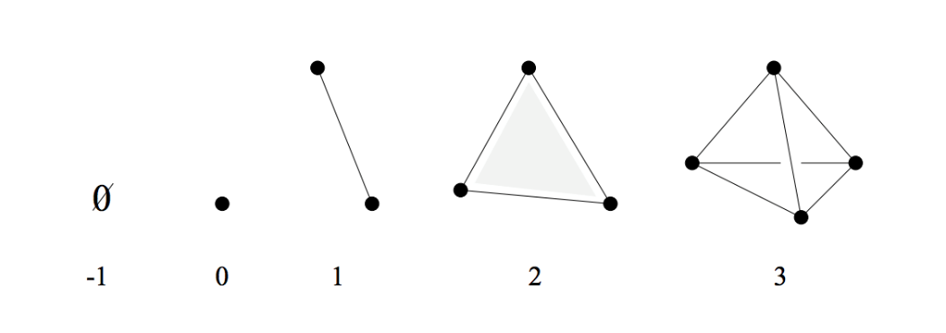
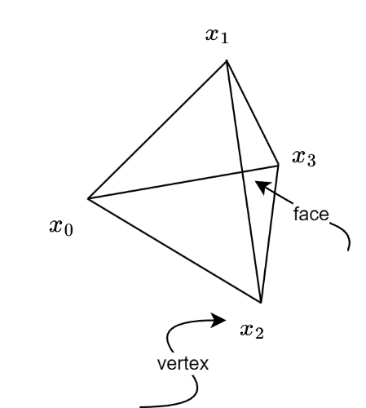
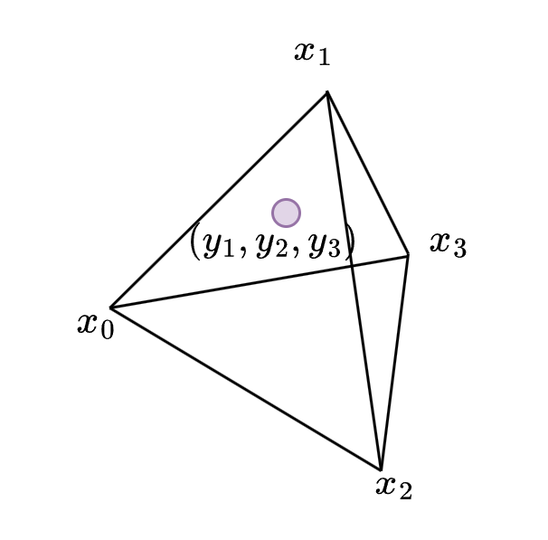


$$\text{Simplex}$$
Sperner’s lemma
$n−$ Simplex (“Triangle” in $n$-dimensions):
set of all convex n-simplex combinations of the affinely independent set of vectors.
$\left(x_{0},x_{1},..,x_{n}\right)=\{\sum_{i=0}^{n}{λ_{i}x_{i}}:∀i∈\left\{0, .. ,n\right\}, λ_{i}≥0 and \sum_{i=0}^{n}{λ_{i}}=1\}$
$n−$ Standard Simplex:
$\left\{\sum_{i=1}^{n}{y_{i}}=1 \right| ∀i , y_{i}>0 \}$ (The triangle that constructed by $\{O,e_{1},e_{2},…e_{n}\}$)
A point $y$ in the Simplex $T$ with the vertices $\{x_{0}, x_{1}, …, x_{n}\}$ :
$y= \sum_{i=0}^{n}{λ_{i}x_{i}}$ (convex combination of vertices.

Slide 6
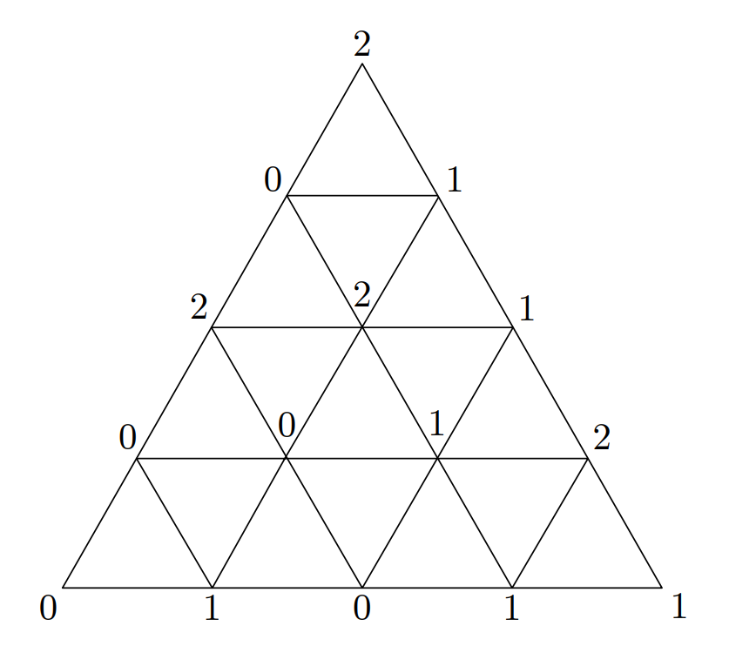

Simplicial subdivision and proper labeling
Sperner’s lemma
A simplex ($T$) is divided to a set of small simplexes (${\{T}_{i}\}$) :
$\bigcup_{T_{i}∈T}{T_{i}}=T$
When 2 $T_{i}$ overlap, the intersection must be an entire face of both subsimplexes.
=> an $(n − 1)$-face of an $n$-subsimplex in a simplicially subdivided:
either on an $(n − 1)$-face of $T_{n}$
or the intersection of two $n$-subsimplexes.
$χ\left(y\right) := \left\{i :λ_{i}>0\right\}$
The indices of vertices that “constructs” it.
$L:V→\{0,…,n\}$
V: the set of all distinct vertices of all the subsimplexes)
Proper labeling : $L\left(y\right)∈χ(y)$
=> the opposition $(n−1)$-face of one vertex won’t contain its index.

Slide 7
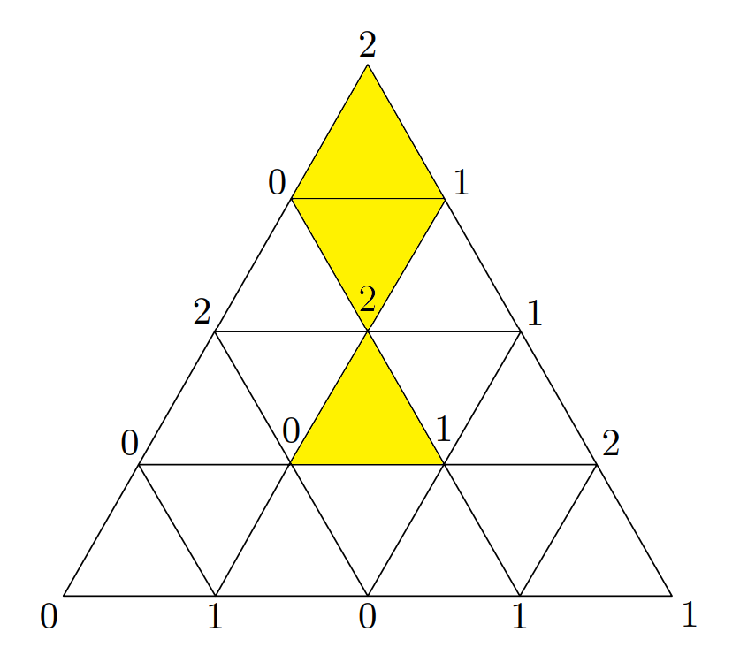

Completely labeling
Sperner’s lemma
A subsimplex is completely labeled if $L$ assumes completely labeled subsimplex all the values 0, . . . , n on its set of vertices

Slide 8

Sperner’s lemma
Sperner’s lemma
Let $T_{n} =(x_{0}, ..,x_{n})$ be simplicially subdivided
$L:$a proper labeling function
Then there are an odd number of completely labeled subsimplexes in the subdivision

Slide 9

Proof (by mathematical induction)
Sperner’s lemma
$T_{0}$ : only possible simplicial subdivision is $\left\{x_{0}\right\}$
$L\left(x_{0}\right)=0$ : 1 completely labeled subsimplex
Satisfied
Assume that $T_{n−1}$ satisfied this lemma. Then for $T_{n}$:
$T_{n}$’s face is an $(n−1)$-simplex
By the assumption, it has odd number of completely labeled subsimplexes in the subdivision.

Slide 10
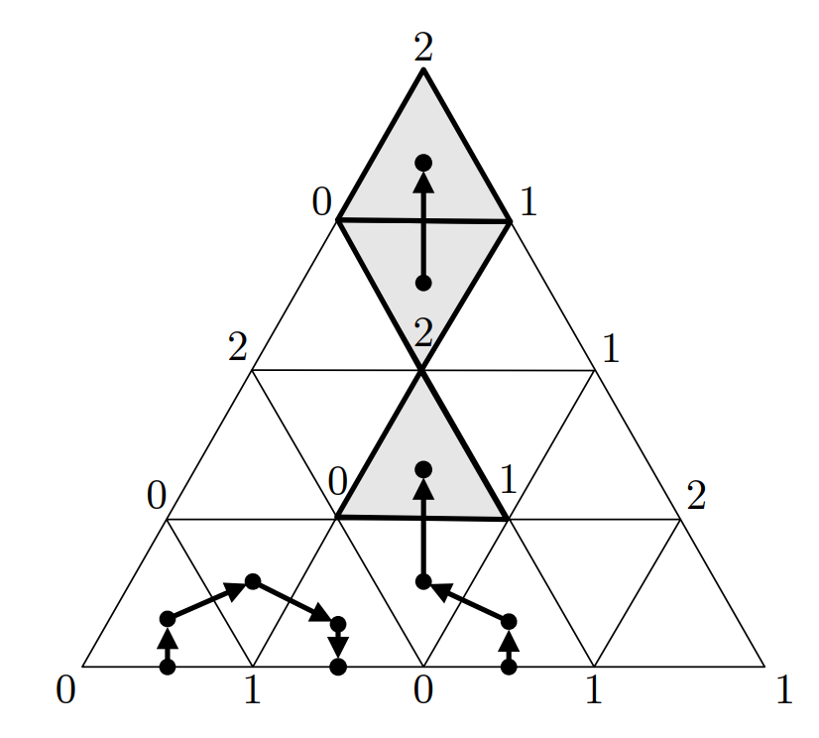

Sperner’s lemma
Walk:
Begin from $b$:
an $\left(n−1\right)$- subsimplex with label $\{0,1,…,n−1\}$ on the face of $T_{n}$
$∃!d∈n−\text{subsimplex}\text{, }\text{d}$ has $b$ as one of its face.
$ver\left(d\right)=ver(b)\bigcap{\text{an} \text{extra} \text{point} z}$ .
If $z.label$ is $n$ :
$d$ has the labels $(0,1,…,n)$
a completely labeled subsimplex!
Else:
$d.$labels contains $(0, . . . ,n−1)$
Only one of the labels ($j$) is repeated , and the label $n$ is missing.
$∃!e≠b ∈(n−1)$-subsimplex that is a face of $d$ and bears the labels $(0, . . . , n − 1)$.
because each $(n − 1)$-face of $d$is defined by all but one of $d$’s vertices.
$b′$: the unique other $n$-subsimplex having $e$as a face
If $b′$ is intersection : walk into it.
Else :$b′$ is an $\left(n−1\right)$-face on $T_{n}$ , stop.

Slide 11

Proof (by mathematical induction)
Sperner’s lemma
The walk ends :
At a completely labeled n-subsimplex: (1)
Find a completely labeled subsimplexes
At a $(n − 1)$-subsimplex with labels $(0, . . . , n − 1)$on the face $T_{n−1}$ (2):
Since the labels are from proper labeling method, start point and end point are at same $(n−1)$-face indeed.
These walks can be backward ! => once an (s,t) show up, (t,s) is a walk, too.
paired ! (Even number)
The assumption : $T_{n−1}$ has an odd number of completely labeled subsimplexes in the subdivision.
i.e. has an odd number of the subsimplexes with label $(0, . . . , n − 1)$
$T_{n}$ has an odd(all) – even(case (2) ) = odd (case (1)) number of completely labeled n-subsimplex.

Slide 12
Proof of Brouwer’s fixed point theorem
by Sperner’s lemma

Slide 13

Brouwer’s fixed point theorem
Brouwer’s fixed point theorem
Let $f$ : $△m → △m$be continuous. ($△m$: a standard simplex)
$\left\{\sum_{i=1}^{n}{y_{i}}=1 \right| ∀i , y_{i}>0 \}$
$f$ has a fixed point.
That is, there exists some $z ∈ △m$ such that $f\left(z\right)= z$

Slide 14
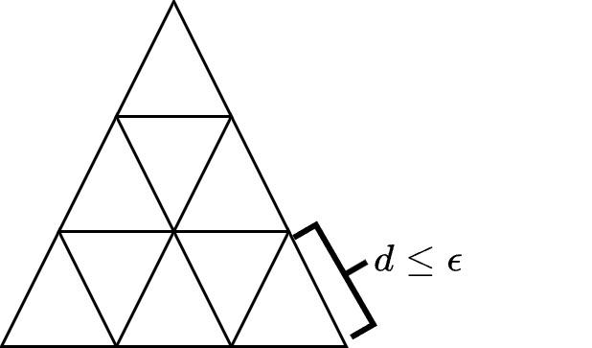

constructing a proper labeling
Brouwer’s fixed point theorem
$f$ : $△m → △m$be continuous. ($△m$: a standard simplex)
constructing a proper labeling of $△m$
Let $ε>0$ , simplicially subdivide $△m$ :
Distance of any two points in the same m-subsimplex $≤ε$
A proper labeling function $L\left(v\right)∈χ(v)\bigcap{f_{i}\left(v\right)≤v_{i}}$
Can be any label i such that $v_{i}> 0$and $f$ weakly decreases the $i^{th}$component of $v$.

Slide 15


To show that $L$ is well-defined (by contradiction)
Brouwer’s fixed point theorem
$L\left(v\right)∈χ(v)\bigcap{f_{i}\left(v\right)≤v_{i}}$
Assume $f_{i}(v) > v_{i} for all i ∈ χ(v)$:
$Δm$ standard simplex: $\sum_{j∈χ(v)}{v_{j}} = \sum_{i=1}^{m}{v_{i}}= 1$
$f_{j}(v) > v_{j} for all j ∈ χ(v)$ :
$$\sum_{j∈χ(v)}{f_{j}(v)}>\sum_{j∈χ(v)}{v_{j}} = \sum_{i=1}^{m}{v_{i}}= 1$$
$⇒ \sum_{j∈χ(v)}{f_{j}(v)}>$ 1
However, the results of $f$ are in standard simplex, $\sum_{j∈χ(v)}{f_{j}(v)}$=1
Contradiction => $L$is well-defined
$L$ is a legal proper labeling function

Slide 16
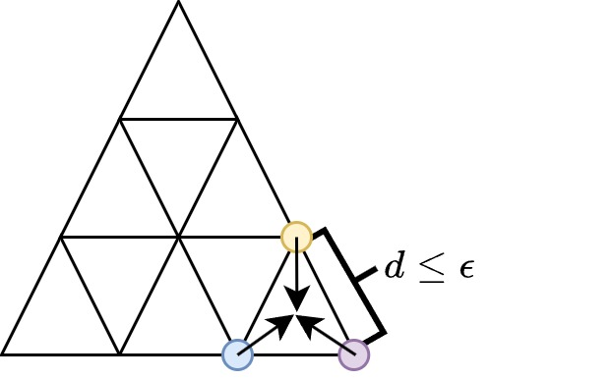

Proof (by Sperner’s lemma)
Brouwer’s fixed point theorem
Since $L$ is a legal proper labeling function :
By Sperner’s lemma, there is at least one completely labeled subsimplex
$$p_{0} · · · p_{m} such that f_{i}(p_{i}) ≤ p_{i} for each i$$
Let $ε→0$ :
consider the sequence of centroids of completely labeled subsimplexes:
Since △m is compact, there is a convergent subsequence.
A limit $z$: $p_{i}→z$for all $i$
$f$ is continuous $⇒f_{i}\left(z\right)≤ z_{i} for all i⇒f\left(z\right)≤z$
Otherwise, $1=\sum_{i}{f_{i}(z_{i})}<\sum_{i}{z_{i}}=1$ contradiction

Slide 17
Note
The situation to prove the existence of NE is on simplotope (a Cartesian product of simplexes), which is the Homeomorphism of simplex.
Brouwer’s fixed point theorem can extend to simplotope.
(The detail proof is in reference)

Slide 18
Proof the existence of NE
by Brouwer’s fixed point theorem

Slide 19

A (finite, n-person) normal-form game
$N:$ n players, indexed by $i$
$A=\left(A_{1}, .., A_{n}\right),A_{i} :$a finite set of actions available to player $i$
$a=\left(a_{1},a_{2},.., a_{n}\right)∈A$ is a pure strategy profile
$u=\left(u_{1},…,u_{n}\right), u_{i}$: utility function for player $i$
Mixed strategy:
For player $i , S_{i}:Π(A_{i})$ : set of all probability distributions over $A_{i}$
Mixed strategy profile: $s∈S=S_{1}×S_{2}×…×S_{n}$ (Cartesian product for all players)
$s_{t}\left(a_{j}\right):$The probability that taking an action $a_{j}$ under profile $s_{t}$,

Slide 20

Utility for a player under mixed strategy
For a mixed stragtegy profile $s∈S$, :
$u_{i}\left(s\right)= \sum_{a∈A}{[ u_{i}(a) \prod_{j=1}^{n}{s_{j}(a_{j})}]}$
Utility under fixed strategy x the probability of the profile happens.

Slide 21

Best Response(BR) and NE
$BR_{i}$ to the profile $s_{−i}$ :
A mixed strategy $s^{∗}∈S_{i}$ $u_{i}(s_{i}^{∗} , s_{−i}) ≥ u_{i}(s_{i}, s_{−i}) for all strategies s_{i} ∈ S_{i}$
Nash equilibrium:
A strategy profile $s = (s_{1}, . . . , s_{n})$is a Nash equilibrium if,
for all agents $i, s_{i}$is a best response to $s_{−i}$ .
i.e. No one can gain more expected utility by a unilateral change of strategy if the strategies of the others remain unchanged

Slide 22

Existence of NE
$Given a strategy profile s ∈ S, for all i ∈ N and a_{i} ∈ A_{i}$:
$φ_{i, a_{i}} (s) = max⁡\{ 0 , u_{i}(a_{i} , s_{−i}) −u_{i}(s)\}$
$f : S → S by f(s) = s ′$ (finding new strategy profile $s′$ ) where
$s_{i}^{′}\left(a_{i}\right)=\frac{s_{i}\left(a_{i}\right)+φ_{i, a_{i}} (s)}{\sum_{b_{i}∈A_{i}}{{s_{i}(b}_{i})}+φ_{i, b_{i}} (s)}$ = $\frac{s_{i}\left(a_{i}\right)+φ_{i, a_{i}} (s)}{1+\sum_{b_{i}∈A_{i}}{φ_{i, b_{i}} (s)}}$
$f$: continuous (since each $φ$ is continuous) $S$: convex and compact
$⇒f$ has at least one fixed point ($s=s′$)
(Brouwer’s fixed point theorem for simplotope)
At least exist one NE for a finite, n-person normal-form game

Slide 23
Thanks

